Slide 1
Particle Swarm Optimization Algorithm Dr. Ahmed Elngar
Faculty of Computers and Artificial Intellegence
Beni-Suef University

Slide 2
Outline
Introduction.
What is PSO ?
Mechanism of PSO and how it works ?
PSO Algorithm.
PSO Examples.
Parameters of PSO.
GA vs PSO.
Types of PSO and comparison.
Advantages & Disadvantages.
Applications of PSO.

Slide 3

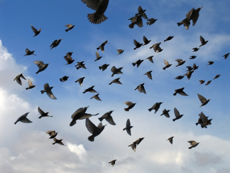
Introduction
Swarm intelligence techniques are recent techniques used to solve many optimization problems. They are used in image processing, machine learning, Neural networks, numerical problems and mechanical problems
Particle Swarm Optimization (PSO)
Developed by James Kennedy & Russell Eberhart in 1995
Inspired from the nature social behavior and communications of birds and fishes
steer toward the center
match neighbors’ velocity
avoid collisions

Slide 4
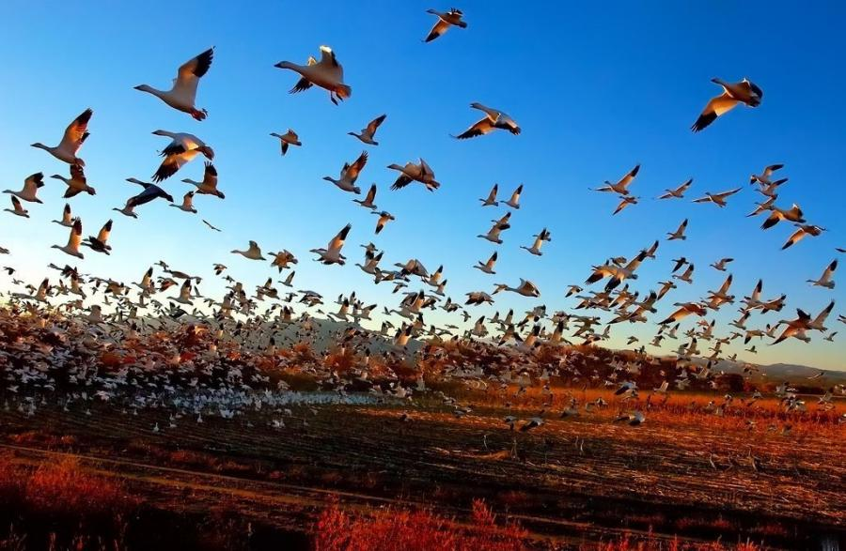
What is PSO ?
Particle swarm optimization (PSO) is defined as computational procedure to recruit or select the most effective element from a collection of accessible alternatives.
PSO was established with an intent to design laptop codes based on simulations of bird flocking around food sources.
For instance, imagine a flock of birds hovering over a region where they can sense hidden supply of food. The one close to food will chirp loudest while other birds will follow the path toward him. Additionally, even if one bird circling opposite approaches nearer to food than primary bird, then this bird chirp louder that makes other birds to follow him.

Slide 5
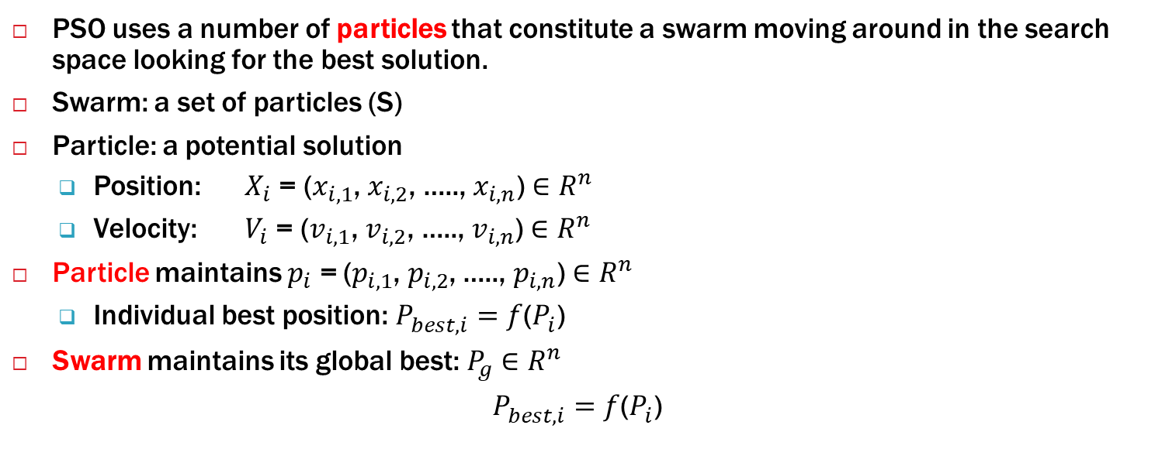
What is PSO ? (cont.)
PSO uses a number of particles that constitute a swarm moving around in the search space looking for the best solution.
Swarm: a set of particles (S)
Particle: a potential solution
Position: $X_{i}$ = ($x_{i,1}$, $x_{i,2}$, ….., $x_{i,n}$) ${∈R}^{n}$
Velocity: $V_{i}$ = ($v_{i,1}$, $v_{i,2}$, ….., $v_{i,n}$) ${∈R}^{n}$
Particle maintains $p_{i}$ = ($p_{i,1}$, $p_{i,2}$, ….., $p_{i,n}$) ${∈R}^{n}$
Individual best position: $P_{best,i}^{ }=f$($P_{i}^{ }$)
Swarm maintains its global best: $P_{g}^{ }{∈R}^{n}$
$P_{best,i}^{ }=f$($P_{i}^{ }$)

Slide 6
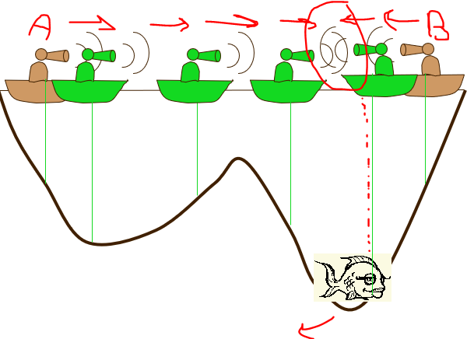

Basic Idea of PSO
Each particle is searching for the optimum.
Each particle is moving and hence has a velocity.
Each particle remembers the position it was in where it had its best result so far (pbest).
The particles in the swarm co-operate. They exchange information about what they’ve discovered. To get the global optimum (gbest)
So each particle keeps track:
its best solution, personal best, pbest.
the best value of any particle, global best, gbest

Slide 7
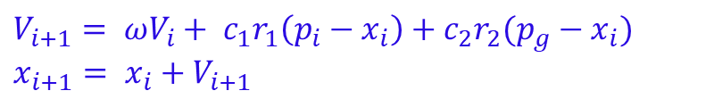
Mechanism of PSO
The goal of PSO is to search in the search space for the positions/locations that are close to the global minimum or maximum solution(s).
So PSO is initialized with a group of random particles (solutions) and then searches for optima by updating generations.
In every iteration, each particle is updated by following two "best" values, (pbest) and (gbest).
After finding the two best values, the particle updates its velocity and positions with following equations.
$V_{i+1}= ωV_{i}+ c_{1}r_{1}\left(p_{i}−x_{i}\right)+c_{2}r_{2}(p_{g}−x_{i})$ $x_{i+1}= x_{i}+V_{i+1}$

Slide 8
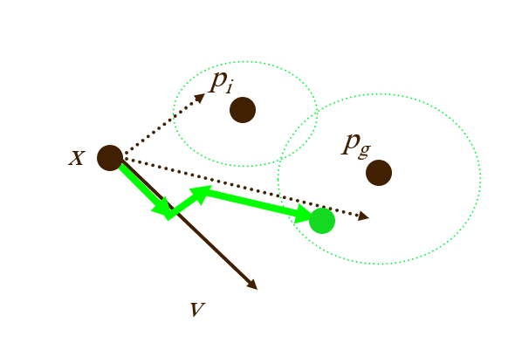
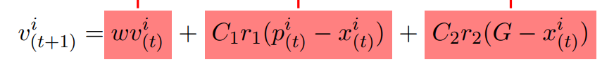
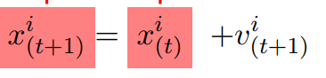
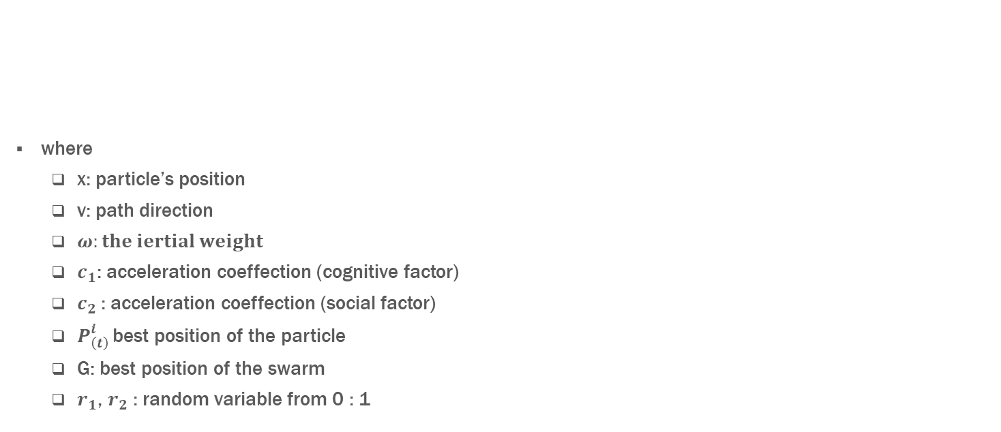
Mechanism of PSO (cont.)
where
x: particle’s position
v: path direction
$ω:the iertial weight$
$c_{1}$: acceleration coeffection (cognitive factor)
$c_{2}$: acceleration coeffection (social factor)
$P_{\left(t\right) }^{i}$best position of the particle
G: best position of the swarm
$r_{1}$, $r_{2}$ : random variable from 0 : 1
Current velocity
Particle memory
Social component
New position
Current position

Slide 9
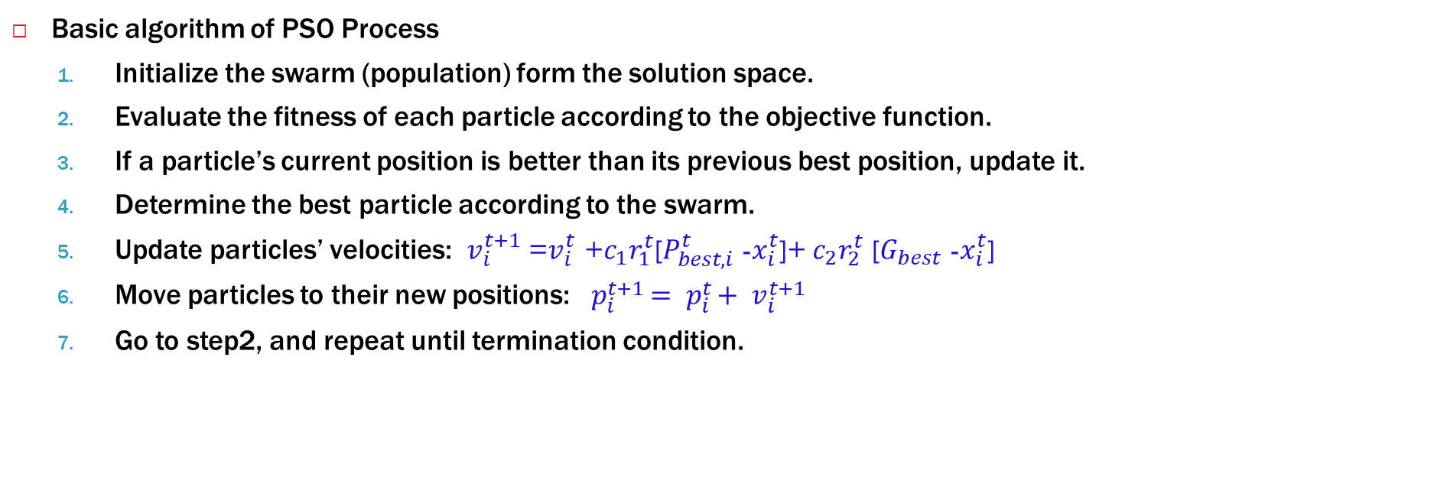
PSO Algorithm
Basic algorithm of PSO Process
Initialize the swarm (population) form the solution space.
Evaluate the fitness of each particle according to the objective function.
If a particle’s current position is better than its previous best position, update it.
Determine the best particle according to the swarm.
Update particles’ velocities: $v_{i}^{t+1}$ =$v_{i}^{t}$ +$c_{1}r_{1}^{t}$[$P_{best,i}^{t}$ -$x_{i}^{t}$]+$c_{2}r_{2}^{t}$ [$G_{best}$ -$x_{i}^{t}$]
Move particles to their new positions: $p_{i}^{t+1}= p_{i}^{t}+ v_{i}^{t+1}$
Go to step2, and repeat until termination condition.

Slide 10
Pseudo code of PSO
p = Particle_Initialization(); for i=1 to it-max for each particle p in P do fp = f(p) if fp is better than f(pBest) pBest = p; end end gBest=best p in P; for each particle p in P do v = v + c1*r1*(pBest - p) + c2*r2*(gBest - p) p =p + v end end

Slide 11
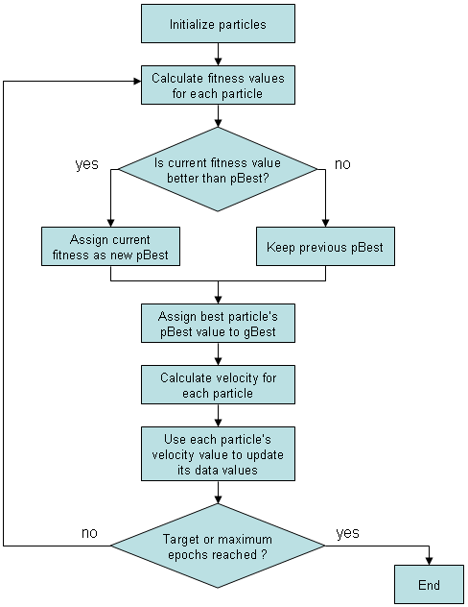
Flowchart of PSO

Slide 12
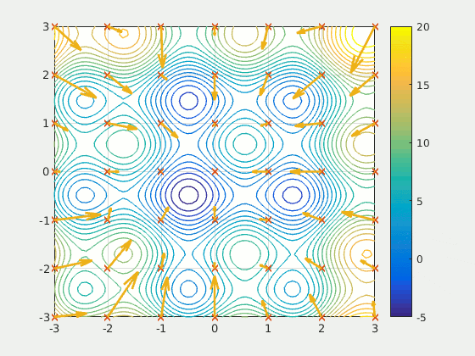
PSO Example 1
Visualization of the best positions during iterations on the contour plot

Slide 13
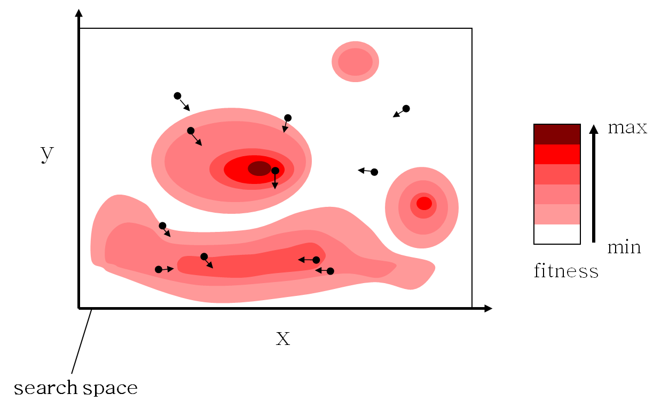
PSO Example 2

Slide 14
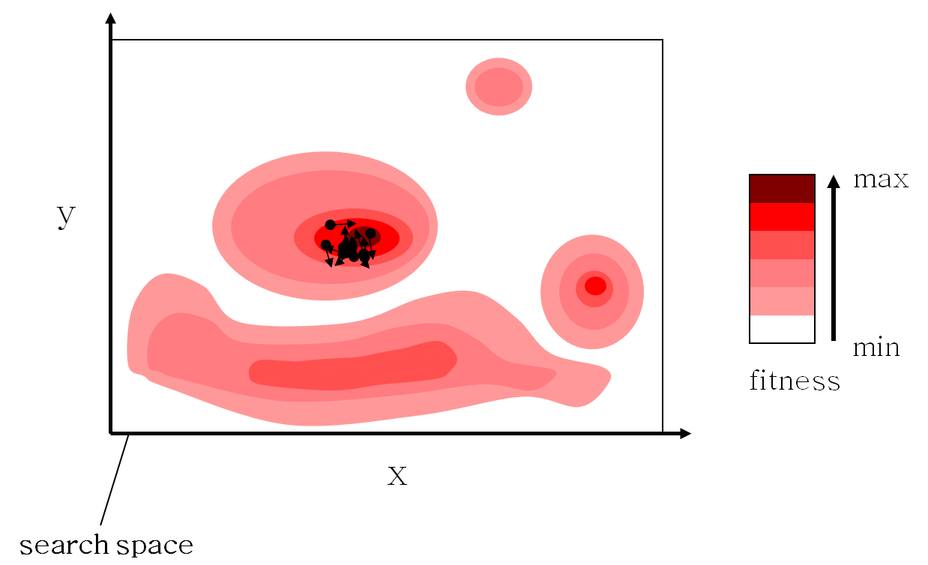
PSO Example 2

Slide 15
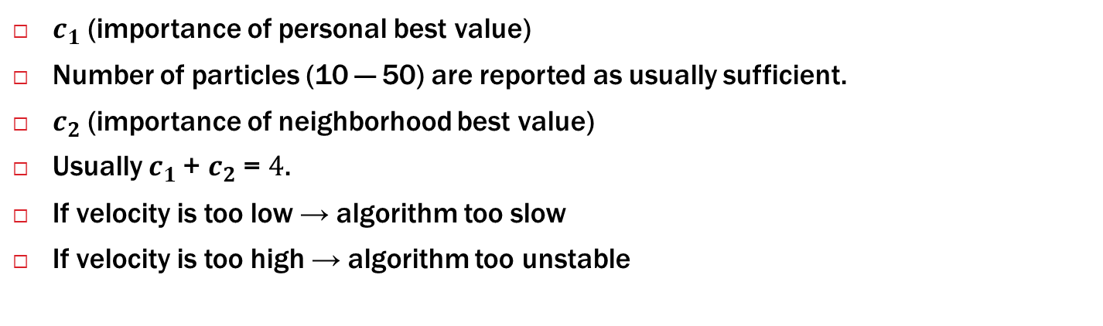
Parameters of PSO
$c_{1}$ (importance of personal best value)
Number of particles (10 — 50) are reported as usually sufficient.
$c_{2}$ (importance of neighborhood best value)
Usually $c_{1}$+ $c_{2}$ = $4$.
If velocity is too low → algorithm too slow
If velocity is too high → algorithm too unstable

Slide 16
GA vs PSO
Commonalities
Both algorithms start with a group of a randomly generated population
Both have fitness values to evaluate the population.
Both update the population and search for the optimum with random techniques
Both systems do not guarantee success.

Slide 17
GA vs PSO (cont.)
Differences
PSO does not have genetic operators like crossover and mutation. Particles update themselves with the internal velocity.
In GAs, chromosomes share information with each other. So the whole population moves like a one group towards an optimal area.
In PSO, only gBest gives out the information to others. It is a one -way information sharing mechanism.
In GAs, the evolution only looks for the best solution.
In PSO, all the particles tend to converge to the best solution quickly.

Slide 18
Types of PSO and comparison
particle swarm optimization (PSO) | modified particle swarm optimization (MPSO) | weight improved particle swarm optimization (WIPSO)
In this algorithm, population parameters were initialized randomly. The velocity of a particle is affected by three components; inertial momentum, social and cognitive components with the following equation: | In this algorithm, the birds have a memory about the previous best and worst positions so that particles have 2 experiences, a bad experience helps each particle to remember its previous worst position. To calculate the new velocity, the bad experience of each particle is considered with the following equation: | the WIPSO algorithm finds the answer with less iteration and with higher speed convergence among the proposed methods. WIPSO algorithms have lower iteration numbers than PSO algorithm. In the WIPSO algorithm, in order to improve the global search quality of standard PSO, the inertia weight factor and the cognitive and social components ( C1 ,C2 ) have been configured with the following equation:

Slide 19
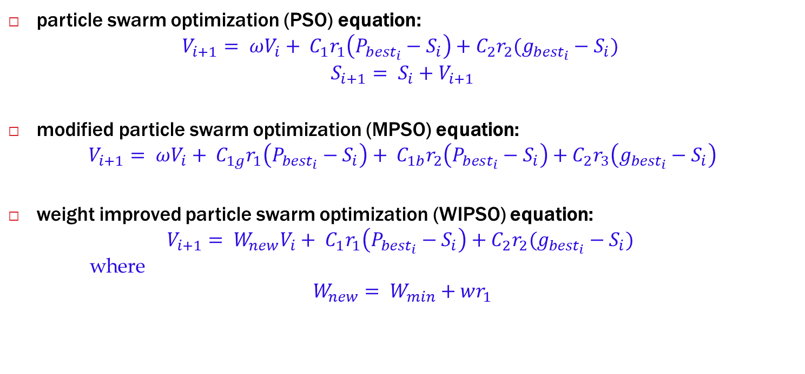
Types of PSO and comparison (cont.)
particle swarm optimization (PSO) equation:
$$V_{i+1}= ωV_{i}+ C_{1}r_{1}\left(P_{{best}_{i}}−S_{i}\right)+C_{2}r_{2}(g_{{best}_{i}}−S_{i})$$
$$S_{i+1}= S_{i}+V_{i+1}$$
modified particle swarm optimization (MPSO) equation:
$$V_{i+1}= ωV_{i}+ C_{1g}r_{1}\left(P_{{best}_{i}}−S_{i}\right)+ C_{1b}r_{2}\left(P_{{best}_{i}}−S_{i}\right)+C_{2}r_{3}\left(g_{{best}_{i}}−S_{i}\right)$$
weight improved particle swarm optimization (WIPSO) equation:
$$V_{i+1}= W_{new}V_{i}+ C_{1}r_{1}\left(P_{{best}_{i}}−S_{i}\right)+C_{2}r_{2}(g_{{best}_{i}}−S_{i})$$
where
$$W_{new}= W_{min}+wr_{1}$$

Slide 20
Advantages & Disadvantages
Advantages | Disadvantages
Simple implementation. | Slow convergence in refined search stage
Few parameters to adjust | Weak local search ability
Derivative-free algorithm | PSO is not exhaustive methods
Calculation in PSO algorithm is very simple | The velocity of information flow between particles leads to the formation of similar particles and thus loss of diversity
Has a short-term memory
Very efficient global search algorithm

Slide 21
Applications of PSO.
Image and video analysis.
Control applications.
Sensors and sensor networks.
Antenna design.
Applications in computer graphics and visualization.
Design applications.
Modeling.
Signal processing.
Robotics.
Prediction and forecasting.

Slide 22


Thanks and Acknowledgement
Thank you

